Slide 1

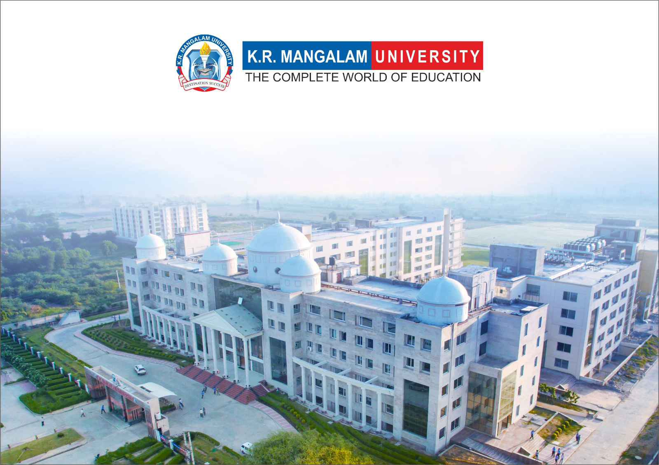
Introduction to Water Chemistry & Hardness
Course Code: ETMLCH104
Course Name: Engineering Chemistry
Program: B.Tech. (AI/ML)
Unit1:Water technology & Chemical Fuels
Dr Pratibha Sharma
Assistant Professor, Department of Chemistry
School of Basic and Applied Sciences
K.R. Mangalam University
Sohna Road, Gurugram

Slide 2

Course Overview
Unit Number: 1 | Title: Water technology | No. of hours: 6
Introduction, water analysis: Hardness-determination by EDTA method, Treatment of boiler feed water: Internal treatment (Phosphate, Colloidal and Calgon conditioning). External treatments: Ion exchange and lime-soda process, Zeolite processes. Boiler scales formation and ill effects, methods of prevention of scales. Numerical problems
Unit Number: 2 | Title: Chemical Fuels | No. of hours: 9
Fuels: Introduction, classification, calorific value (HCV & LCV), Determination of calorific value of fuel using Bomb calorimeter. Solid fuel: Coal- its analysis by proximate and ultimate analysis, Numerical problems. Liquid fuels: Refining of petroleum, Petroleum cracking, Knocking in IC engine, its ill effects and prevention of knocking. Anti-knocking agent: Leaded and unleaded petrol. Gaseous fuels: LPG, CNG and their applications.
Unit Number: 3 | Title: Battery Technology | No. of hours: 10
Introduction - Galvanic cell, electrode potential, EMF of the cell and cell representation. Batteries and their importance, Classification of batteries- primary, secondary and reserve batteries with examples. Battery characteristics - voltage, capacity, energy density, power density, energy efficiency, cycle life and shelf life. Construction, working and applications of: Ni-Cd, and Lithium-ion battery. Working principle of an electric vehicle.
Unit Number: 4 | Title: Polymer | No. of hours: 5
Basic concepts of polymer, Types of polymers, Thermoplastic & thermosetting plastics, Preparation and application of some industrially important polymers (Natural rubber, Buna S, Buna-N, Neoprene, Isoprene, Nylon-6, nylon-6,6 , Decron and Terylene). Conducting and biodegradable polymers.

Slide 3
COURSE OUTCOMES
CO1: Understand the methods for water hardness and the basics of boiler water treatment and analyze fuel calorific values and battery.
CO2: Explain the characteristics and working principles of different battery types and types of fuels.
CO3: Determine the differences between batteries and fuel cells and classify fuel cell types based on their components..
CO4: Identify between hard and soft water, solve the related numerical problems on water purification and emf and its significance in industry and daily life.

Slide 4
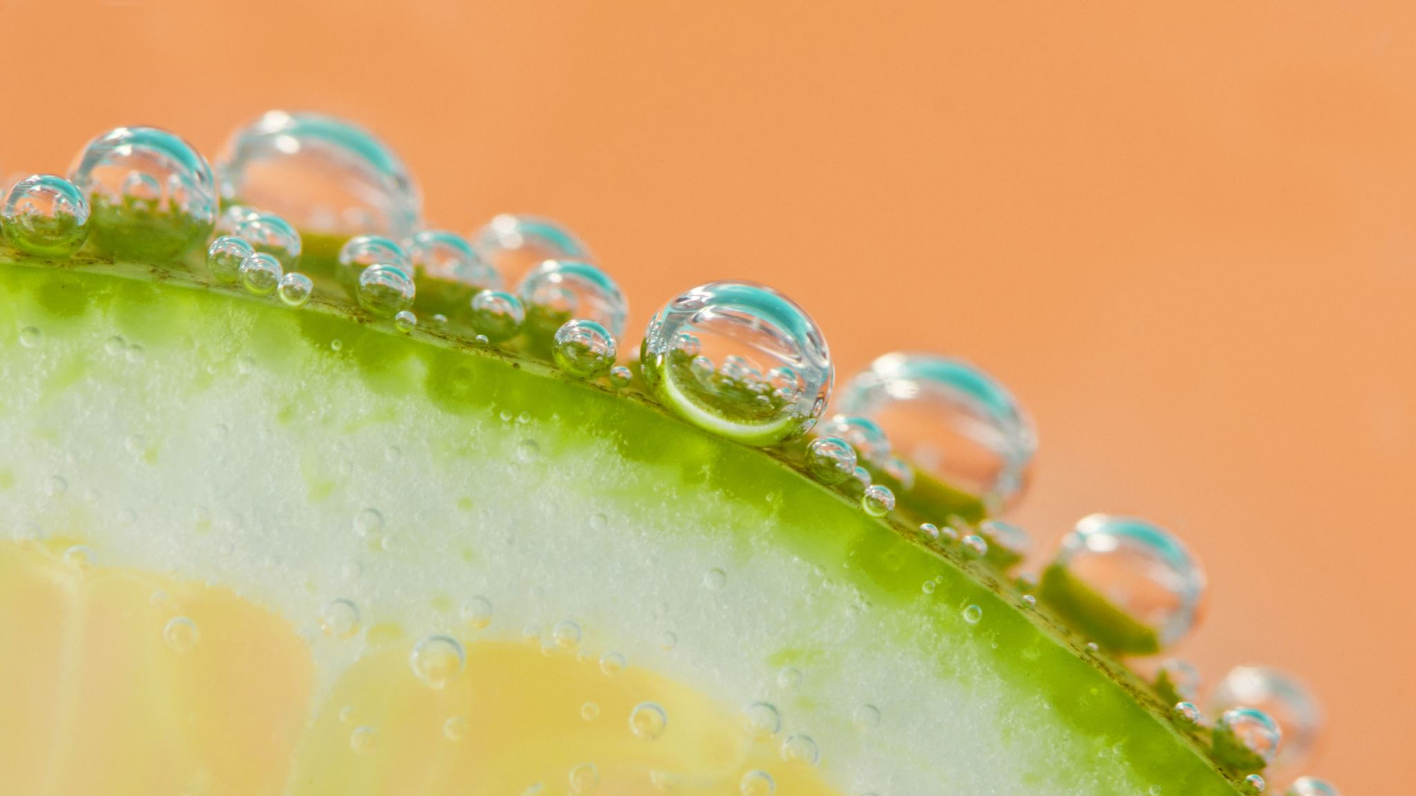
External Treatment Method
Lime-soda Process

Slide 5

Techniques for water softening (External treatment)
Lime-soda process
Hot-Lime Soda process
Cold-Lime Soda process
Zeolite Process
Ion-Exchange Method
Cation-exchange
Anion-exchange

Slide 6
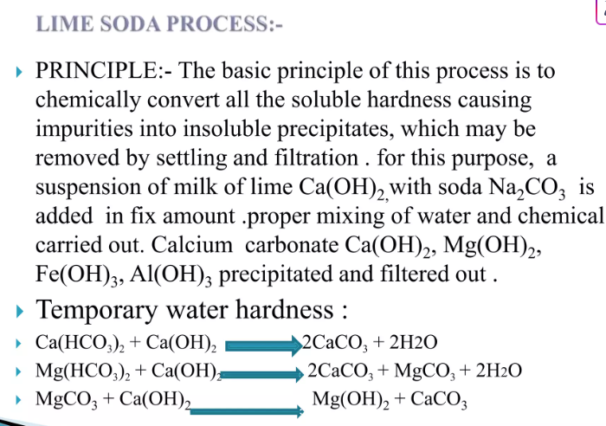

Slide 7
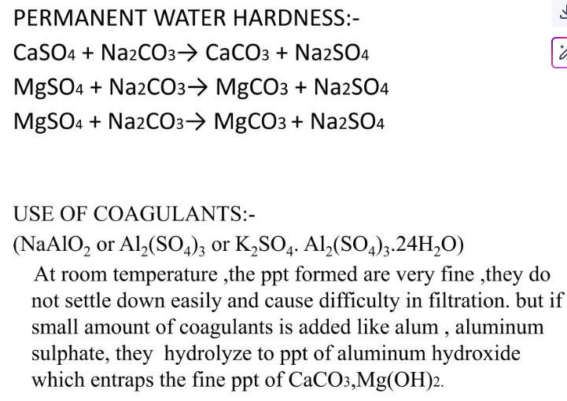

Slide 8
Techniques for water softening (External treatment)
Lime-soda process:
In this process, hydrated lime & sada ash use to remove hardness from water.
i) Hydrated lime:
Hydrated lime is used to remove temporary hardness of water. It react with Ca(HCO₃)₂ & Mg(CO₃)₂ to form insoluble precipitate of calcium carbonate and magnesium hydroxide respectively.
Ca(HCO₃)₂ + Ca(OH)₂ 2CaCO₃↓ + 2H₂O
Mg(HCO₃)₂ + 2Ca(OH)₂ Mg(OH)₂↓ + 2CaCO₃↓ + 2H₂O
Hydrated lime is also used to remove permanent hardness (magnesium salt impurities only) from water. It reacts with MgSO₄ & MgCl₂ to form insoluble precipitate of magnesium hydroxide.
MgCl₂ + Ca(OH)₂ Mg(OH)₂↓ + CaCl₂
MgSO₄ + Ca(OH)₂ Mg(OH)₂↓ + CaSO₄

Slide 9
Techniques for water softening (External treatment)
In above reaction calcium based impurities like CaCl₂ & CaSO₄ also form, which are soluble in water. Therefore, calcium based impurities (CaCl₂ & CaSO₄) are not removed by lime treatment.
ii) Soda ash:
Sodium carbonate (Na₂CO₃) is used to remove permanent hardness of water which caused by MgSO₄ & MgCl₂ or CaCl₂ & CaSO₄.
CaCl₂ + Na₂CO₃ CaCO₃↓ + 2NaCl
CaSO₄ + Na₂CO₃ CaCO₃↓ + Na₂SO₄
MgCl₂ + Na₂CO₃ MgCO₃↓ + 2NaCl
MgSO₄ + Na₂CO₃ MgCO₃↓ + Na₂SO₄

Slide 10
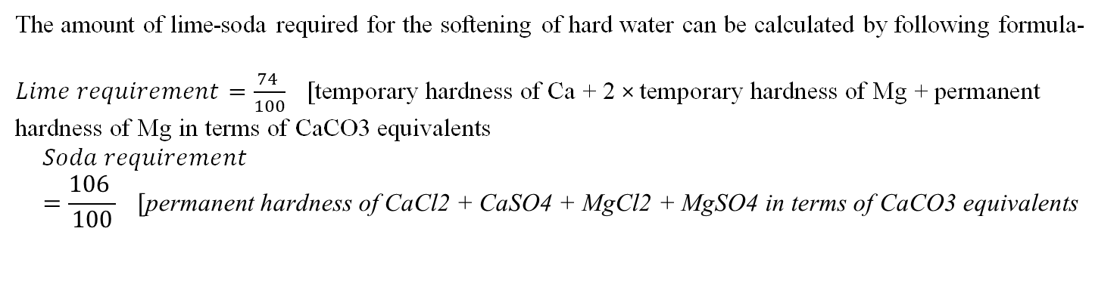
Techniques for water softening (External treatment)
The amount of lime-soda required for the softening of hard water can be calculated by following formula-
$Lime requirement=\frac{74 }{100} [\text{temporary} \text{hardness} \text{of} \text{Ca}\text{ + 2 }\text{×} \text{temporary} \text{hardness} \text{of}$ $\text{Mg}\text{ + }\text{permanent} \text{hardness} \text{of} \text{Mg} \text{in} \text{terms} \text{of} \text{CaCO}\text{3 }\text{equivalents}$
$$Soda requirement=\frac{106 }{100} [\text{permanent} \text{hardness} \text{of} \text{CaCl}\text{2 + }\text{CaSO}\text{4 + }\text{MgCl}\text{2 + }\text{MgSO}\text{4 }\text{in} \text{terms} \text{of} \text{CaCO}\text{3 }\text{equivalents}$$

Slide 11
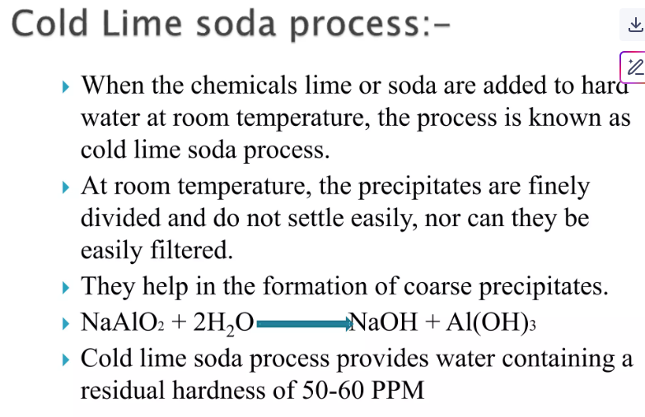

Slide 12
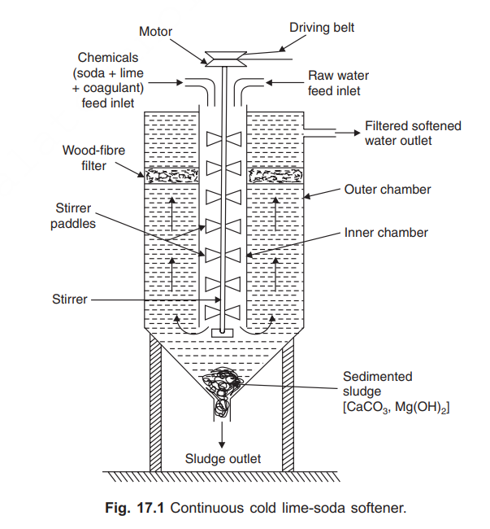
Techniques for water softening (External treatment)

Slide 13
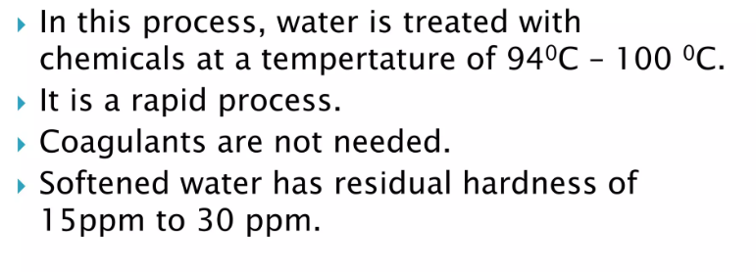
Hot Lime Soda Process

Slide 14
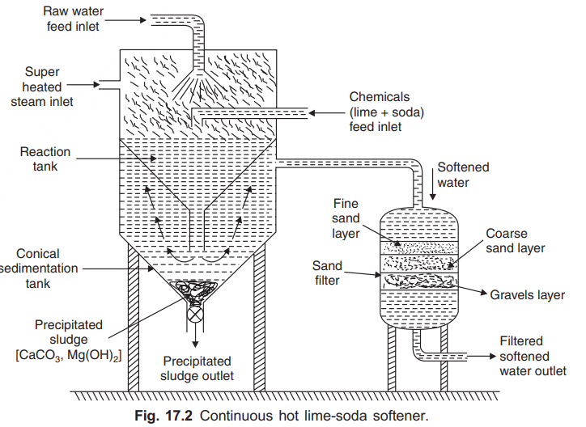
Techniques for water softening (External treatment)

Slide 15
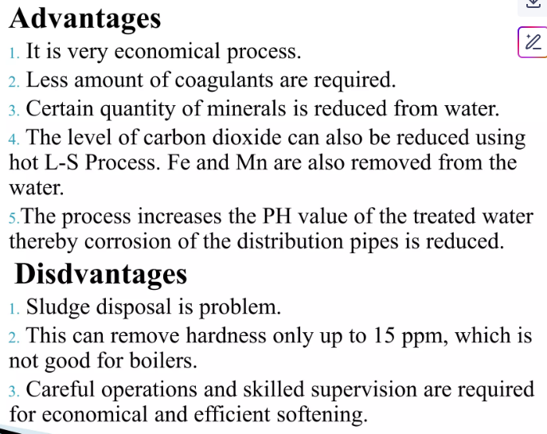

Slide 16
Take away of the session
Purpose: Removes hardness from water using chemical precipitation.
Chemicals Used: Lime (Ca(OH)₂) removes temporary hardness; soda ash (Na₂CO₃) removes permanent hardness.
Process: Hardness-causing ions form insoluble precipitates (e.g., CaCO₃, Mg(OH)₂) which are then removed.
Types: Cold lime-soda (room temp) and hot lime-soda (better efficiency due to higher temp).
Applications: Commonly used for municipal and industrial water softening.

Slide 17
Questions
What is the main purpose of the lime-soda process? A. Disinfection of water B. Removal of turbidity C. Softening of hard water D. pH adjustment
Which chemical is used in the lime-soda process to remove temporary hardness? A. Na₂CO₃ B. Ca(OH)₂ C. HCl D. K₂SO₄
What is the role of soda ash (Na₂CO₃) in the process? A. Removes magnesium hardness B. Acts as a coagulant C. Removes permanent calcium hardness D. Increases water pH
Which of the following is an advantage of the hot lime-soda process over the cold one? A. Lower efficiency B. Slower reaction rate C. Better removal of hardness D. Lower cost of operation
What is formed as a precipitate when lime reacts with temporary hardness? A. NaCl B. CaSO₄ C. MgCl₂ D. CaCO₃

Slide 18
References
Engineering Chemistry by Jain and Jain.

